Slide 1

Of CORS It’s Exploitable! What’s possible with CORS?
Rebecca Deck
@ranger_cha
BE INFORMED. BE STRATEGIC. BE SECURE.

Slide 2
OVERVIEW
CORS Bypasses
CORS & Scanners
Multi-step CORS Exploits
CORS Defenses

Slide 3
WHAT IS CORS?
Browser protection
Stops one site from forcing XHR (XML HTTP Requests) to another
Defined in Fetch spec
Very granular
Generally more complex than CSRF tokens
Easy to misconfigure

Slide 4


CORS DETAILS
Client
Pre-flight OPTIONS
Server
Pre-flight Response
Actual Request
Actual Response

Slide 5
CORS REQUEST HEADERS
Origin (Most Important)
Access-Control-Request-
Method
Headers

Slide 6
CORS RESPONSE HEADERS
Access-Control-Allow
Origin (ACAO)
Credentials
Methods
Headers
Access-Control-Expose-Headers
Access-Control-Max-Age

Slide 7
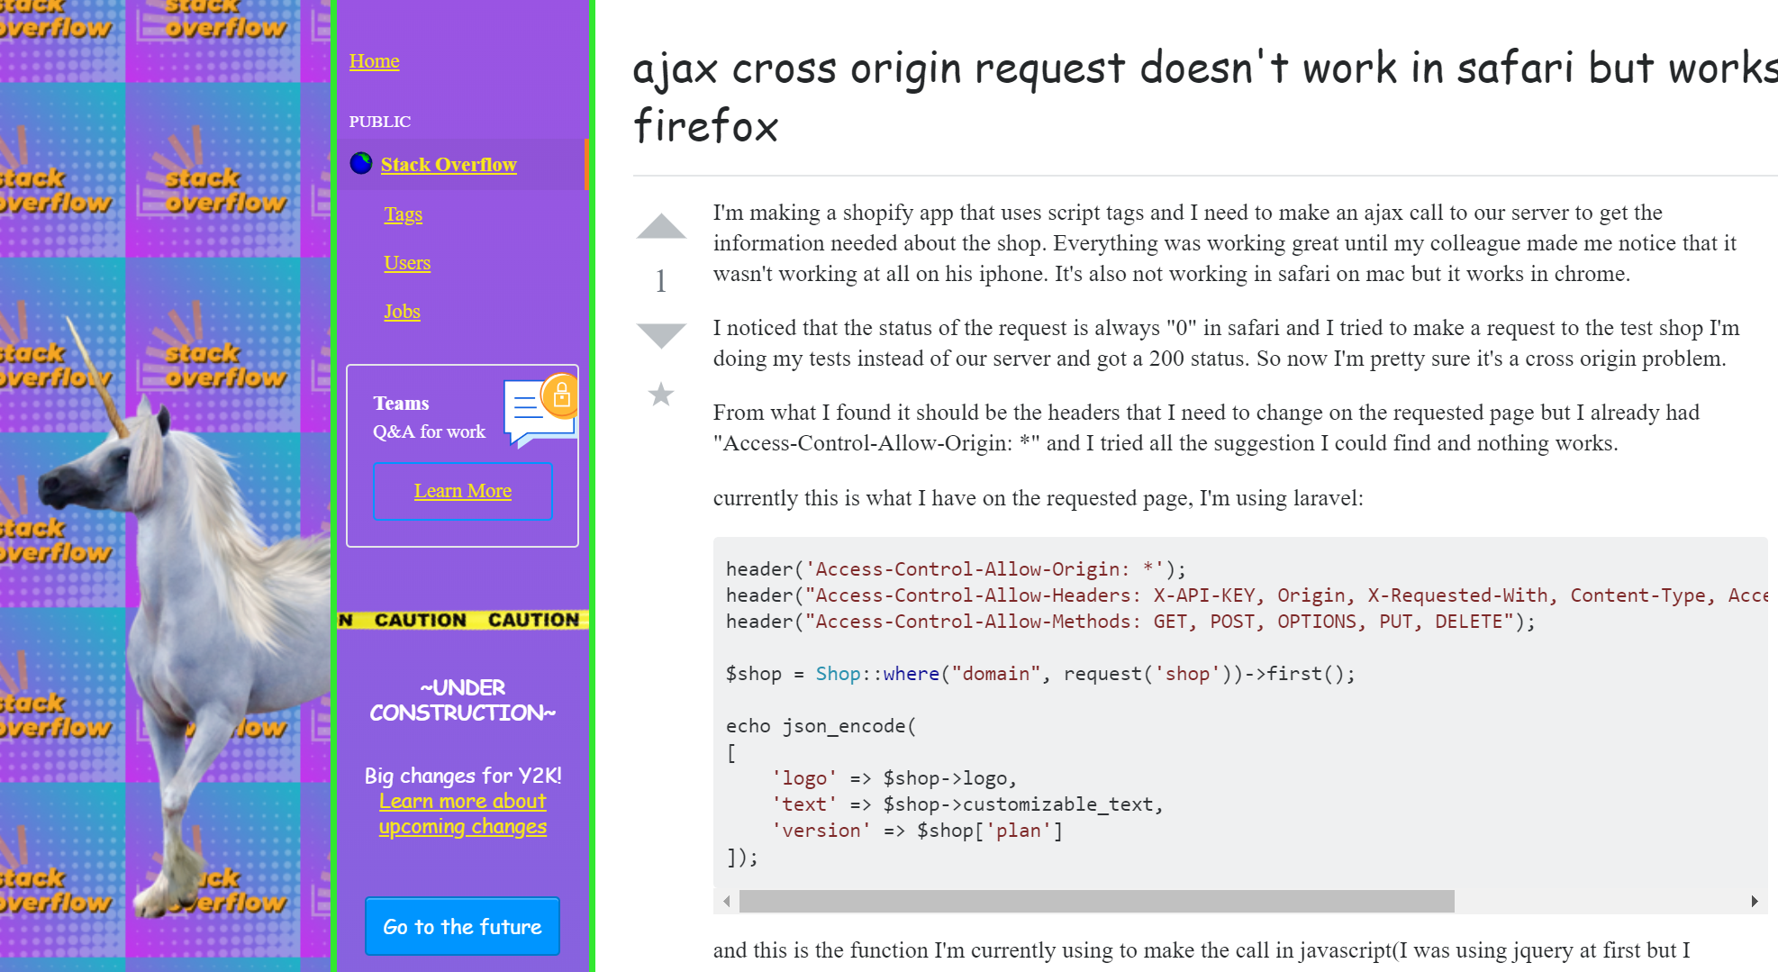

Slide 8
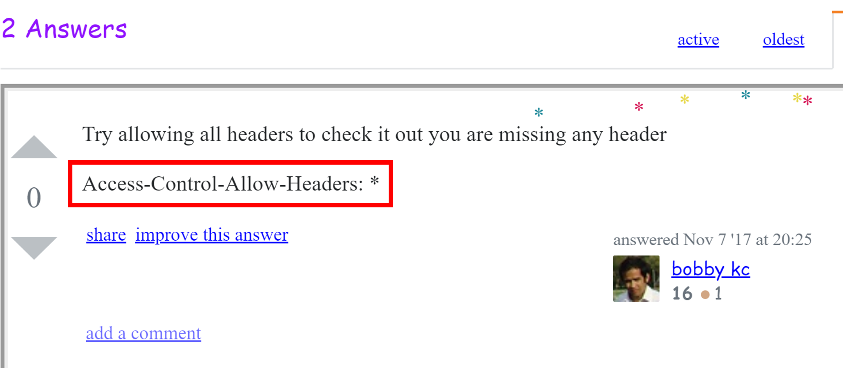

Slide 9
BYPASSING CORS Origin
Origin controls where requests come from
Fundamental to CORS security
ACAO supports wildcards & exact matches
*
Only for open APIs
https://www.good.local

Slide 10
BYPASSING CORS Origin
Access-Control-Allow-Credentials
Send cookies
Send Authorization (basic & NTLM)
Does not support wildcards in origin
Often parrots origin header
Hard to do check origin for on-prem apps
Otherwise, uses regex
May be wrong

Slide 11
BYPASSING CORS Origin Examples
Regex | Bypass with
.* | Literally anything
good.local | goodalocal.evil.local
^.*good\.local | good.local.evil.local

Slide 12
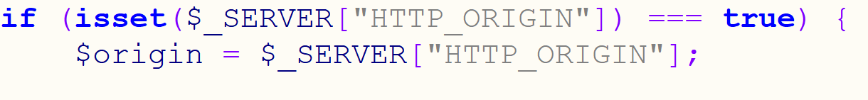
BYPASSING CORS Bad Origin Example Code

Slide 13
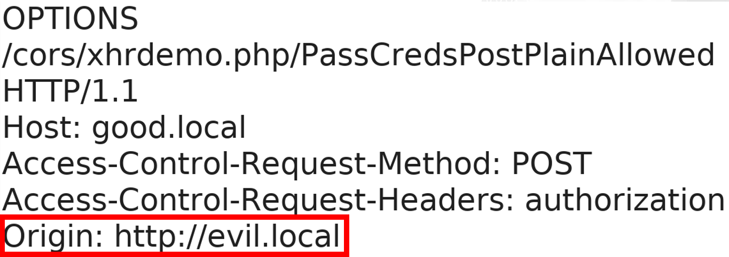
BYPASSING CORS
Client
Pre-flight
Server

Slide 14
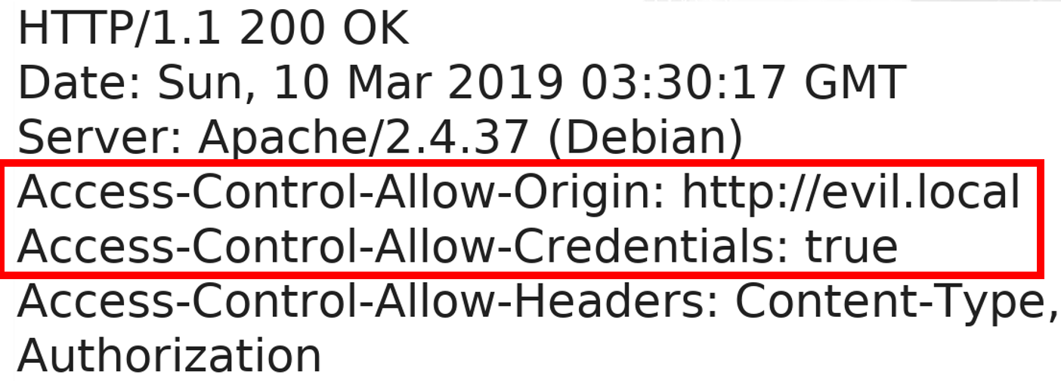
BYPASSING CORS
Client
Pre-flight Response
Server

Slide 15
BYPASSING CORS Avoiding Pre-flight Requests
Simple requests
GET, HEAD, or POST
A few headers
Content-Type
application/x-www-form-urlencoded
multipart/form-data
text/plain

Slide 16
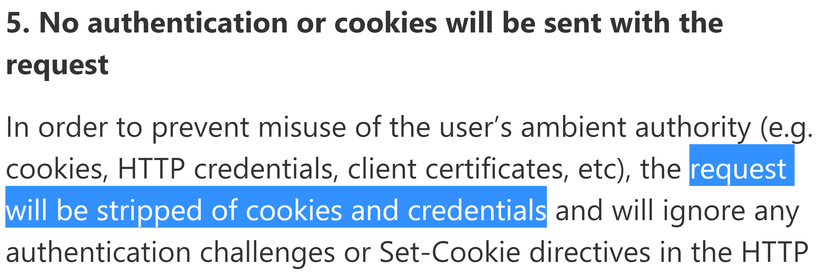
BYPASSING CORS Avoiding Pre-flight Requests
https://blogs.msdn.microsoft.com/ieinternals/2010/05/13/xdomainrequest-restrictions-limitations-and-workarounds/

Slide 17
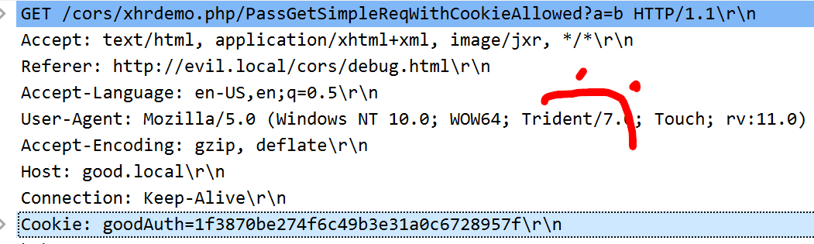
BYPASSING CORS Avoiding Pre-flight Requests
(╯°□°）╯︵ ┻━┻

Slide 18
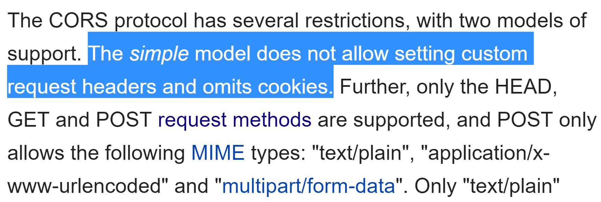
BYPASSING CORS Avoiding Pre-flight Requests
https://en.wikipedia.org/wiki/XMLHttpRequest

Slide 19
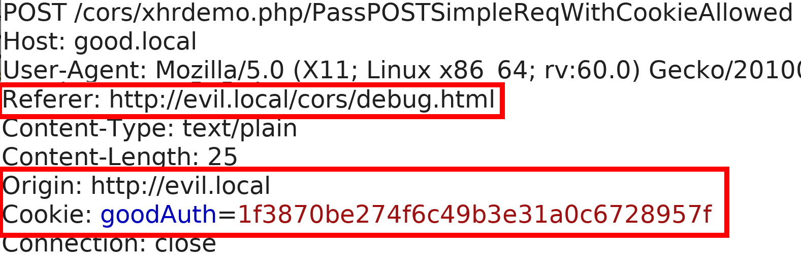
BYPASSING CORS Avoiding Pre-flight Requests Examples
Client
POST
Server

Slide 20
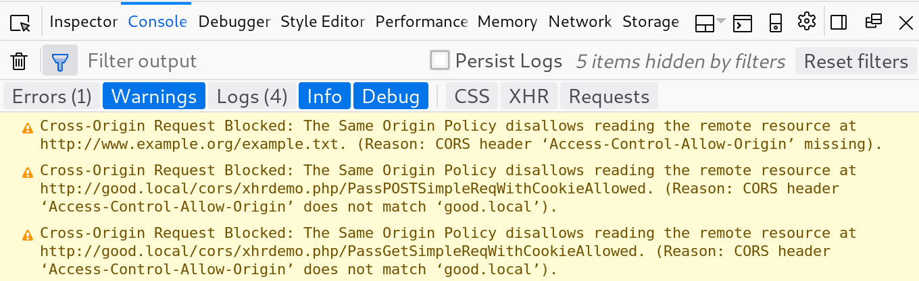
BYPASSING CORS Avoiding Pre-flight Requests Examples

Slide 21
COMMON CORS PITFALLS BY TESTERS
Scanners are pretty sad
Over-reliance on Origin
Ignoring custom headers
Forget the pre-flight
Don’t modify multiple parts of the request
Customers think we are wrong
They have been hurt before!
Thinking we’re limited to one request
Think GUIDs protect them

Slide 22
MULTI-STEP CORS EXPLOIT EXAMPLE
Software handling financial payments
GET to REST API to list all accounts
POST to REST weird "prepare to update" step with GUID
POST to REST API to update direct deposit
Reflected Origin header
Session cookie to handle authentication
Used WithCredentials on XHR

Slide 23
MULTI-STEP CORS EXPLOIT EXAMPLE
Five-step exploit
Request list of accounts
Parse JSON to retrieve account info
“Prepare to edit” Request
Get GUID
POST to update direct deposit
Scanner finding (from Burp)
CORS Arbitrary Origin Trusted

Slide 24
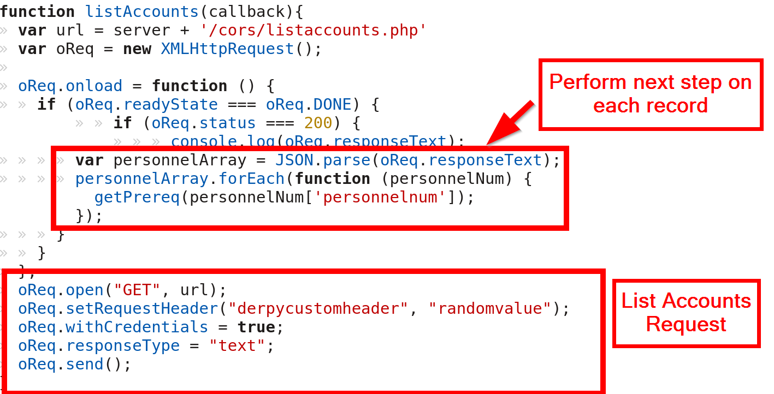
MULTI-STEP CORS EXPLOIT EXAMPLE

Slide 25
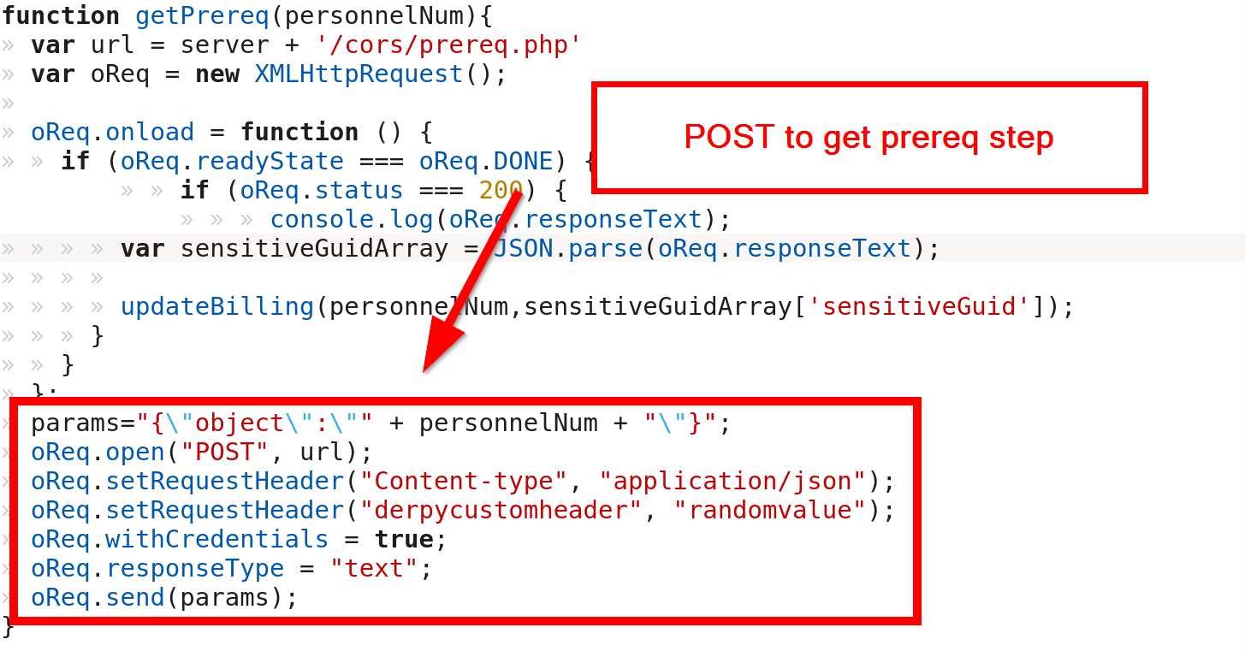
MULTI-STEP CORS EXPLOIT EXAMPLE

Slide 26
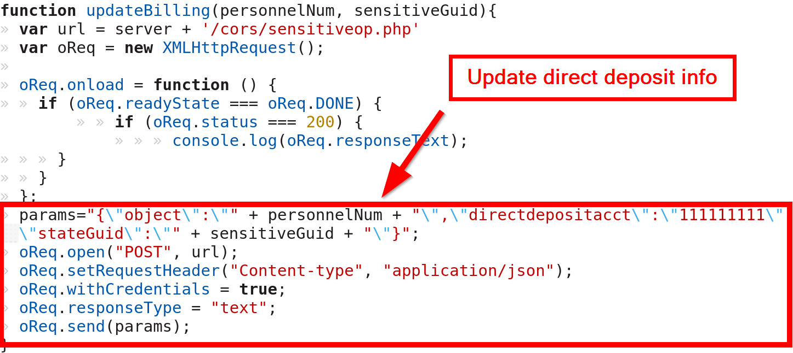
MULTI-STEP CORS EXPLOIT EXAMPLE

Slide 27
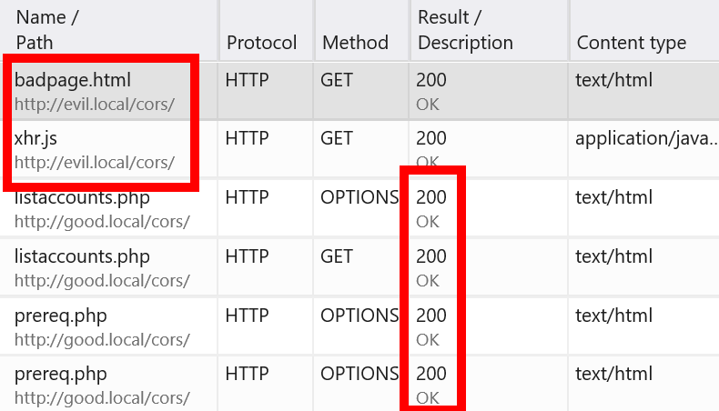
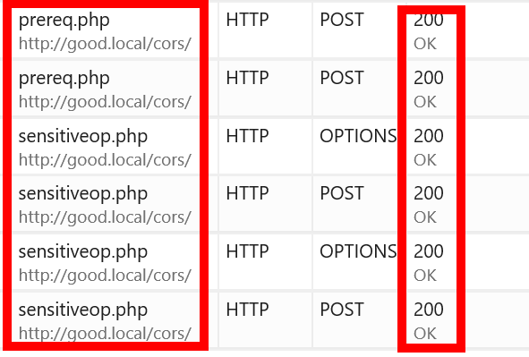
MULTI-STEP CORS EXPLOIT EXAMPLE

Slide 28
CORS DEFENSES
Intentional Defenses
Origin Header
Limit as much as possible
Use regex and whitelists
Nonce Tokens
Double submit cookies
Accidental Defenses
Custom Headers

Slide 29
DO AUTHORIZATION HEADERS HELP?
Sites with access to token must have no XSS
Token must be unpredictable
Token must be unique per user
Receiving system must validate token
Attacker must not be able to generate tokens for another user
Apps must never put the token in an insecure place (URL)

Slide 30
SUMMARY
CORS secures XHR requests
Origin is important!
Attack with “simple” requests
Multi-step attacks are possible!

Slide 31
RESOURCES
Portswigger CORS
https://portswigger.net/blog/exploiting-cors-misconfigurations-for-bitcoins-and-bounties
Mozilla CORS Info
https://developer.mozilla.org/en-US/docs/Web/HTTP/CORS
W3C CORS
https://www.w3.org/TR/cors/
OWASP CSRF
https://github.com/OWASP/CheatSheetSeries/blob/master/cheatsheets/Cross-Site_Request_Forgery_Prevention_Cheat_Sheet.md

Slide 32
RESOURCES
Fetch Spec
https://fetch.spec.whatwg.org/
Example XHR Code
https://github.com/rangercha/CORSRequestPOC
CORS Exploitation Framework (not out)
Detailed CORS Simple Requests Research
https://research.aurainfosec.io/same-origin-policy/

Slide 33
www.directdefense.com

